Slide 1
Rugby World Cup 2011 Volunteer Programme
Public Forum
June/July 2010

Slide 3
Thanks
Notes:
Introduce Brendon
Introduce the team there
Thanks
For coming
For your time
For your commitment
For being interested
Thanks to the volunteer hosts that escorted you to the venue and seats

Slide 4
Today
RWC background
Keeping it real (our expectations of you)
The good stuff (benefits)
The Journey you’ll take
Next steps

Slide 5
Some Background
A bit about the Rugby World Cup 2011

Slide 6
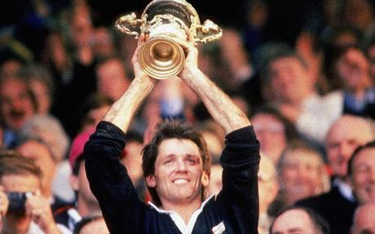
Previous Winners
1987 New Zealand (in New Zealand)
1991 Australia (in UK)
1995 South Africa (in South Africa)
1999 Australia (in UK)
2003 England (in Australia)
2007 South Africa (in France)
Notes:
Note:
Michael Jones scored the first try of the first RWC and the first try in the final

Slide 7
RNZ 2011 Key Strategic Goals
Goal One: Delivering an operational excellent Tournament
Goal Two: Achieving capacity crowds and achieving the RNZ 2011 budgeted financial result or better
Goal Three: Inspiring a nationwide Rugby World Cup festival
Goal Four: Creating enduring benefits

Slide 8
Numbers Game
443
63
105
5000+
20,000
1.6m
60-80k
48
13 +10
4b
Notes:
452 Days to go
64 Monday’s to go – so there is time
65 Staff
105 Staff by Cup time
5000+ Volunteers
Approx 20k workforce – so you’re not alone
1.6m Tickets to sell
60-80k Int’l visitors
48 Matches
13 Match Venues + 10 Team Host Towns
4 Billion broadcast audience
Introduce Martin video

Slide 10
Keeping it real
Things you need to know before you register!

Slide 11
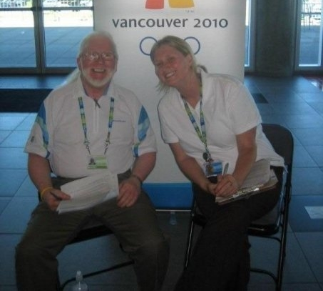
Minimum Requirements
At least 17
Minimum number of days/shifts
Speak and understand English
Excellent understanding of New Zealand and its culture
Agree to terms and conditions
Willing to undergo Police check (if required for the role)
Commit to Volunteer Agreement
Notes:
Minimum Requirements
At least 17 at time of application
Minimum number of days/shifts (plus training)
Speak and understand English
Excellent understanding of New Zealand and its culture
Agree to terms and conditions of participation
Willing to undergo Police check (if required for the role)
Commit to Volunteer Agreement

Slide 12
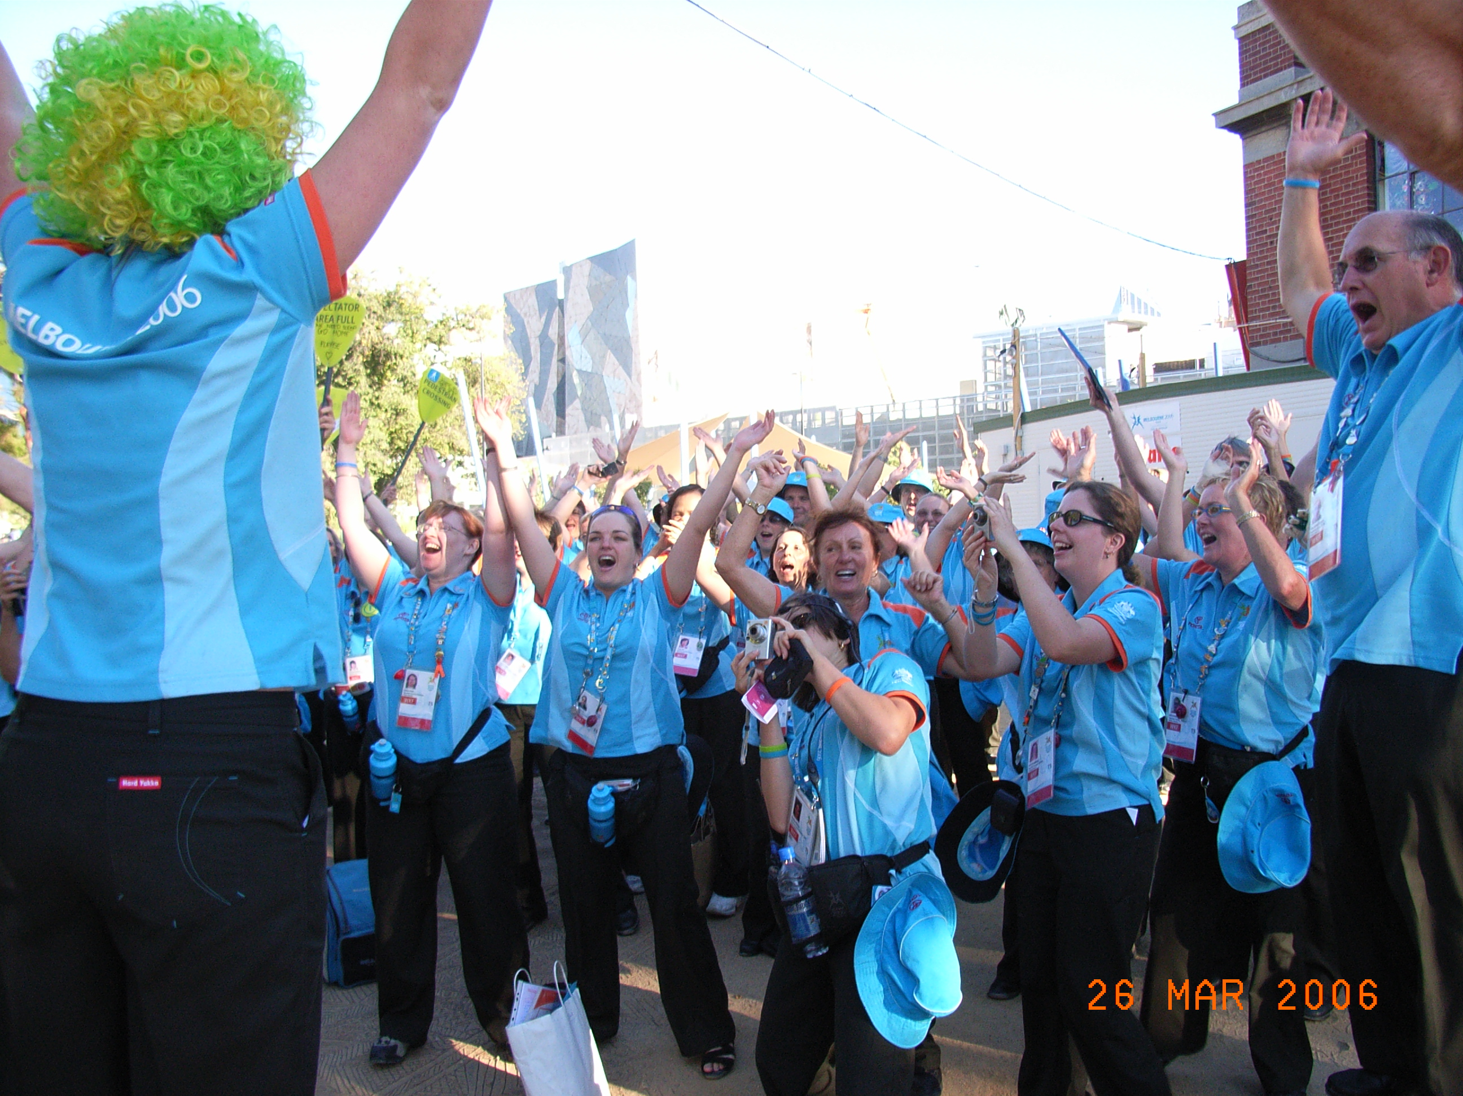
Core Values
We need you at all times, to be:
Committed
Passionate
Motivated
Proud and positive
Hard working
Committed Team Member

Slide 13
Being there
Responsible for your travel to the host city
Responsible for your own accommodation
A once in a lifetime experience
Notes:
Also mention that we have already received 13,500 expressions of interest - Many from overseas!
A once in a lifetime experience - be part of the biggest event of the 2011 year

Slide 14
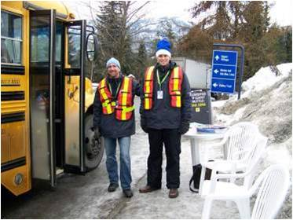
Hard Work
6-8 hour shifts
Standing around
Some very repetitive jobs/days
Cold, wet and dark (or sunny and hot!)
Assist non-English speakers
Must remain positive, upbeat and welcoming at all times
Notes:
Hard Work
6-8 hour shifts
Lots of standing around (sore legs)
Some roles probably very boring some days
Could be cold, wet and dark (may also be sunny and hot!)
Likely to have to assist non-English speaking people
Need to remain positive, upbeat and welcoming at all times

Slide 15
Setting the Scene
Notes:
Story about the Melbourne Volunteers

Slide 16
The Realism
Very few roles inside the stadium
No free tickets
Unlikely to see any games while Volunteering
Unlikely to meet any rugby stars
Notes:
So buy a ticket if you want to be a match!!!
Introduce Volunteer Ambassador Michael Jones video:
Member of the inaugural RWC 1987 champion New Zealand side
Scored the first try of the first Rugby World Cup in 1987
Played 55 Tests for New Zealand from 1987 to 1998
Coach of Manu Samoa 2004 - 2007
Founder of the Village Sports Academy which provides training opportunities for at risk Pacific Island youth in Central and West Auckland
Chairs a community trust which provides mentoring services to West Auckland schools

Slide 18
The Good stuff
What’s in it for you?
Your journey from registration to celebration

Slide 19
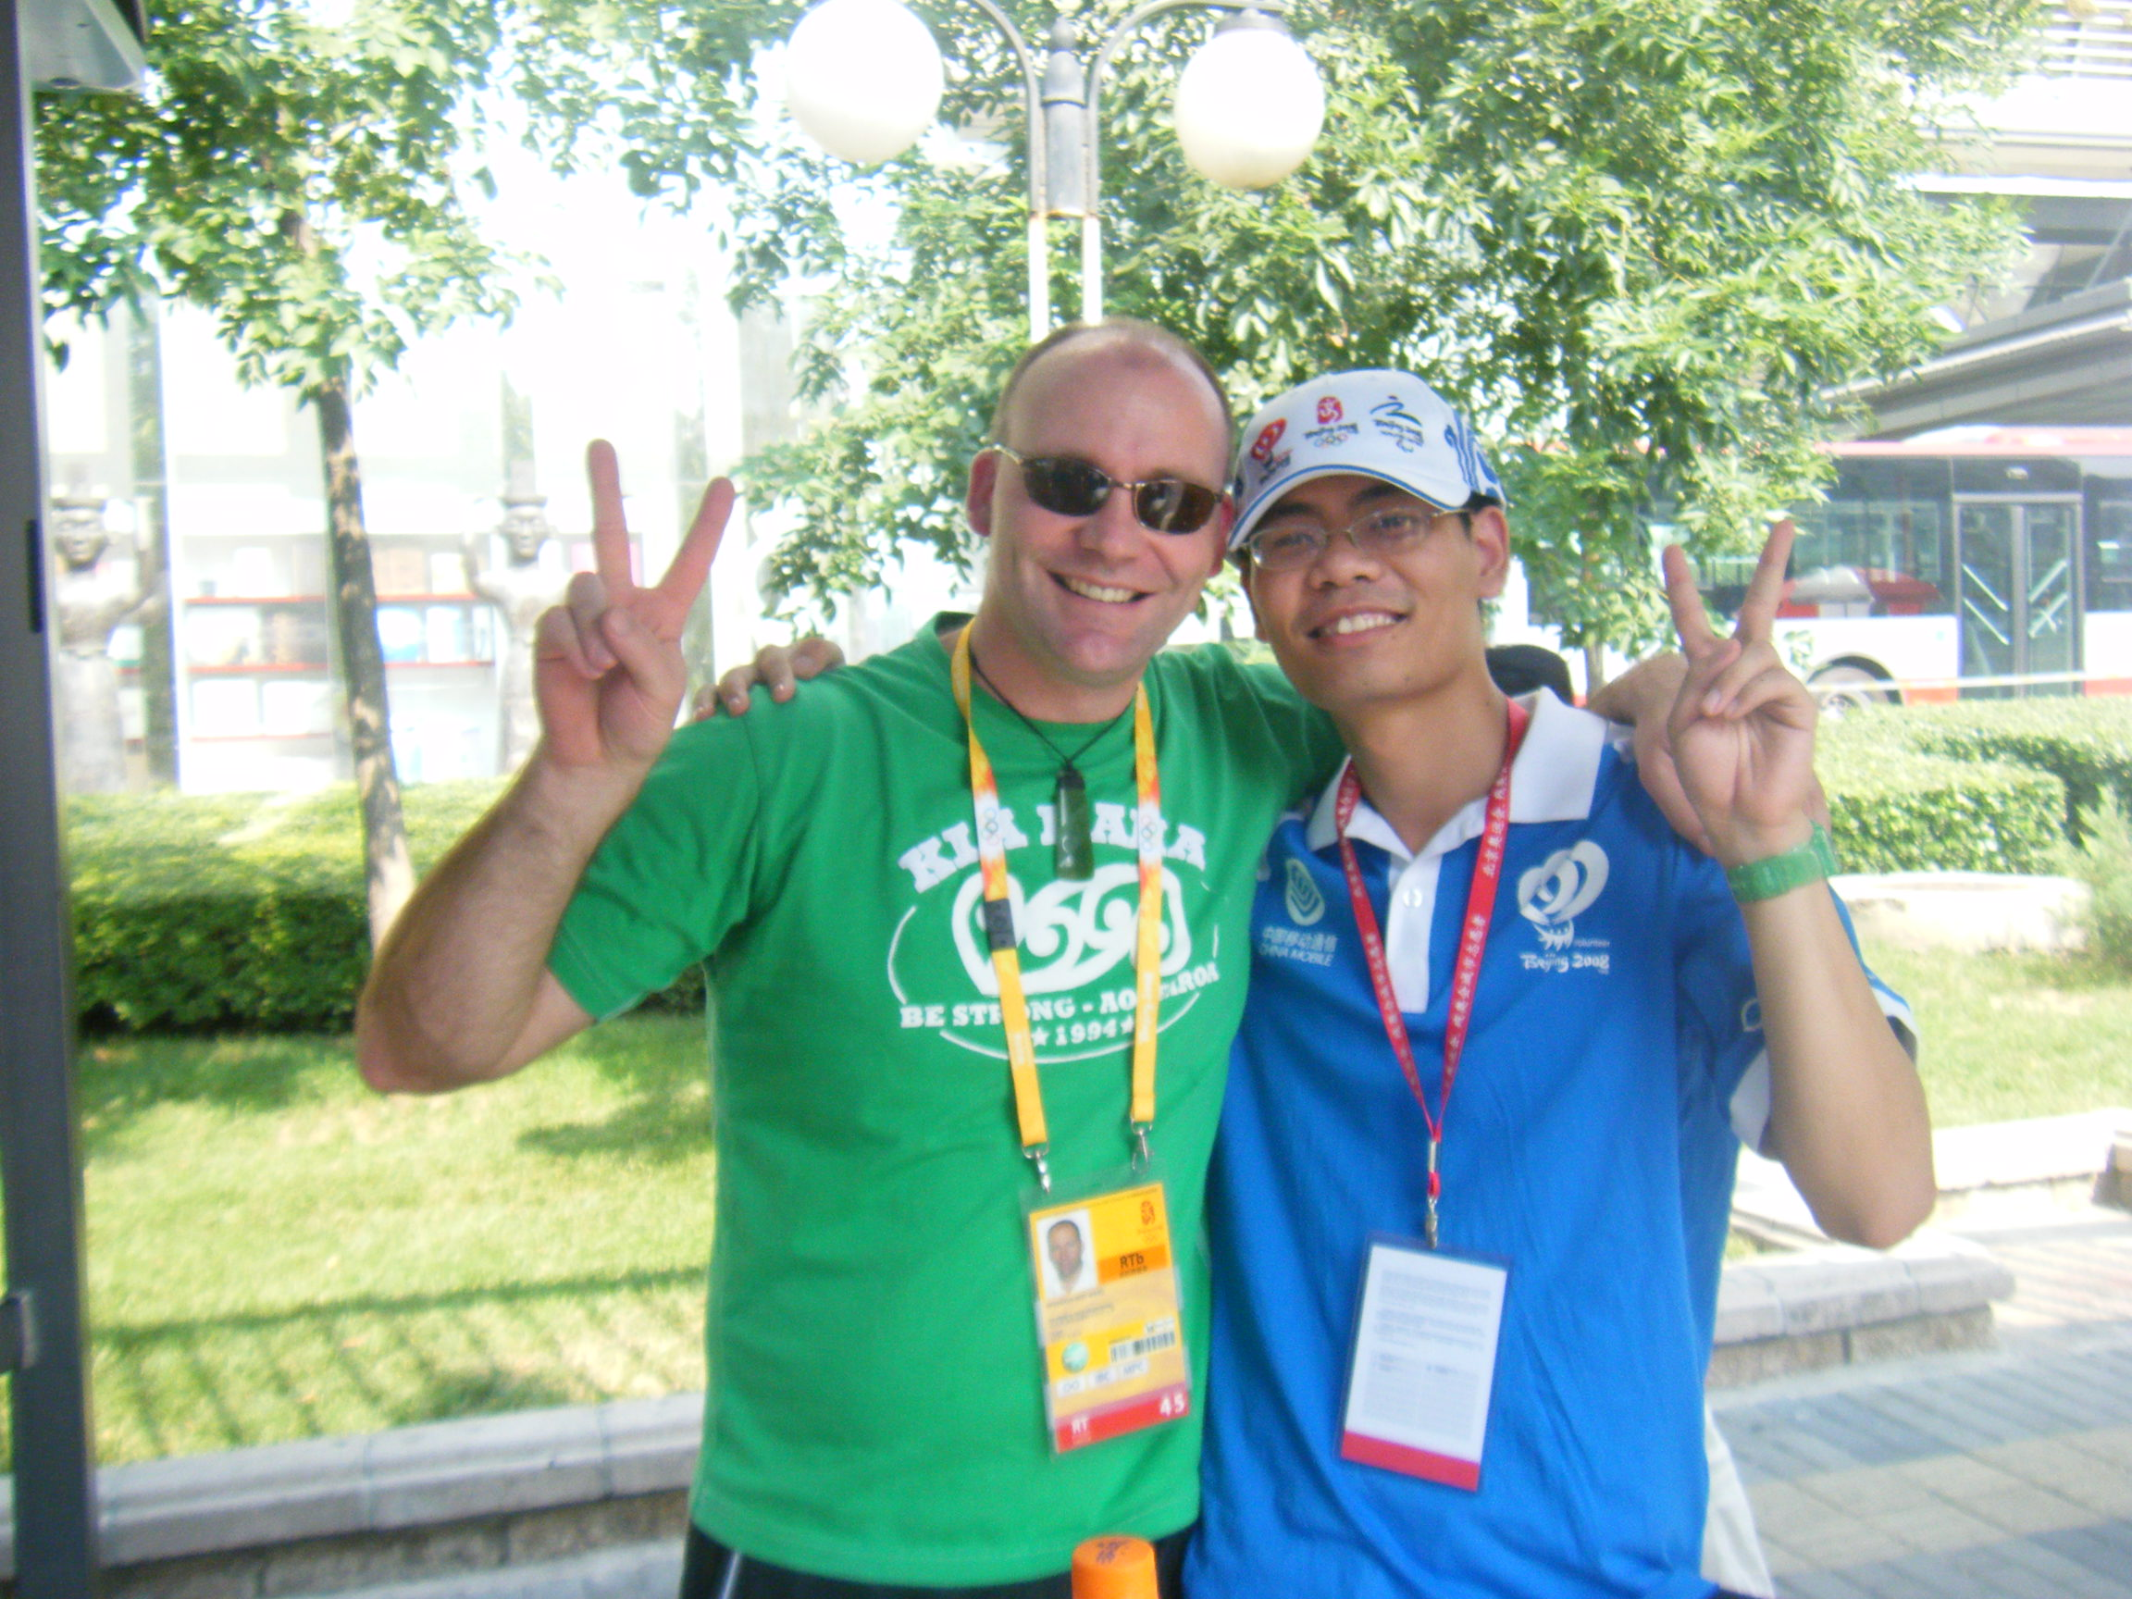
For You!
Networking
Pride
3rd largest sporting event
Host the world
Training
Uniform
Recognition
Friends
Memories
Notes:
For You
Training
Keep your Uniform
Contribution recognised
Fantastic friends
Lifetime memories
Social networking and Volunteer network (own facebook)
Part of 3rd largest sporting event in the world
Host the world

Slide 20
Volunteer Journey
2010
2011
June
July
October/ November
January
May
July
August
September/ October
Volunteer
Launch
In person Interviews
Offers Start
Tournament Time
Public forums & registrations
Training commences
Rosters distributed
Venue Based Training commences
Wrap parties
Uniform & Accreditation distribution begins
Volunteer Emails

Slide 21
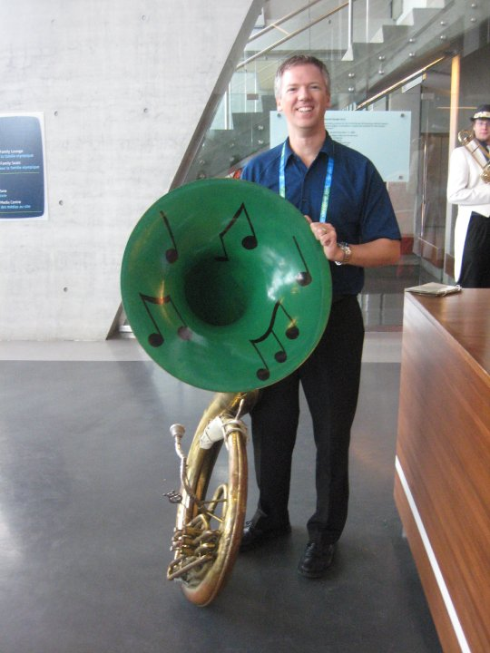
“Right person for the role.”
Technical skills/experience
Operational requirements
Customer service and volunteering
Leadership
Passion
Manaakitanga
Notes:
“Right person for the role.”
Technical skills/experience required for the role
Operational requirements (age, time commitment, English speaking ability, accommodation)
Understanding of customer service and volunteering
Leadership skills / experience
Passion about your town/city/region/country
Commitment to deliver the BEST hosting experience

Slide 22
Walk up interview format
We meet you and you meet us!
Informal
20 minutes
Confirm availability, skills and experience
Operational questions and technical questions
Regional
Notes:
Informal
Max 20 minutes – may need to allow 1-2 hours for queues
Confirm availability, skills and experience
Operational questions and technical questions
Completed at a regional level

Slide 23
Training
Three phases beginning May 2011
Orientation/Generic (online)
Job Specific (classroom)
3. Venue specific (venue)
Leadership training and Train the trainer

Slide 24
Work Areas
Accommodation
Accreditation
Catering
Ceremonies
City Operations
Media Operations
Sports Presentation
Ticketing
Tourist Information
Transport
VIP Programme
Workforce

Slide 26
Roles
RWC 2011 Festival Hosts
Tourist Information Host
Transport Hub Hosts
Coach Load Zone Officer
VIP Hosts
VIP Administrators
Workforce Squad
Ceremonies Support
Spectator Services Squad
Drivers
Fleet Centre Operations
Hotel Hosts
Airport Welcome Hosts
Media Assistants
Attendance Recorders
Catering Standards Monitor
Only select 3 roles when you register

Slide 27
Registration
Register online
Help available at Libraries and i-SITES
Own email address
We will communicate with you electronically
Email / cell phone
Login to update registration details any time
Notes:
Registration
Everyone must register online
Everyone will need there own email address
Online registrations = easy way to communicate with you electronically
Everyone can login to update their registration details at any time

Slide 28
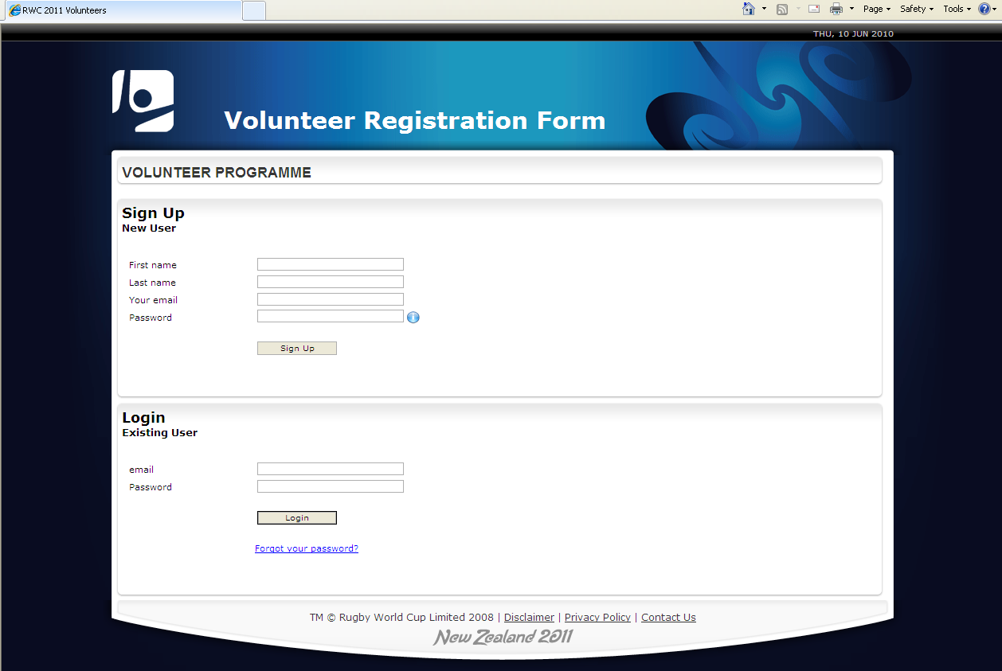

Slide 29
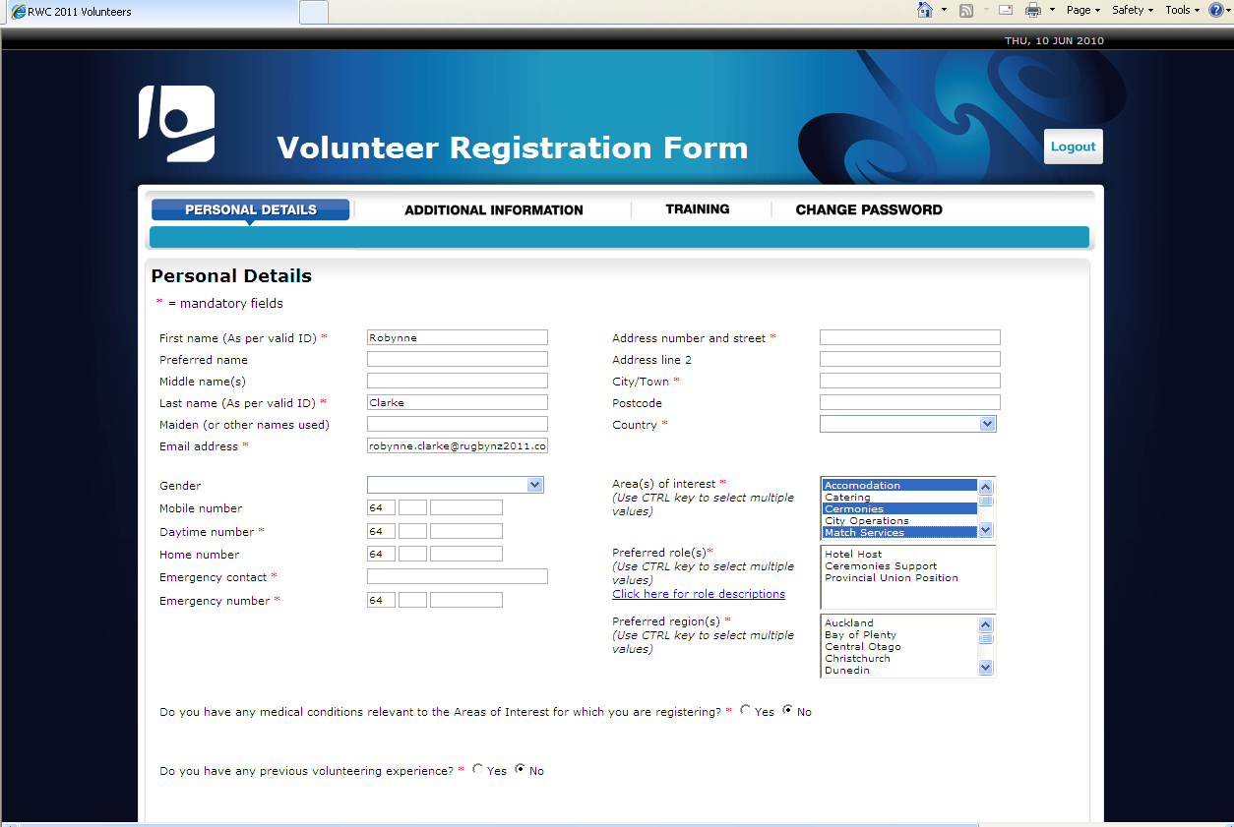

Slide 30
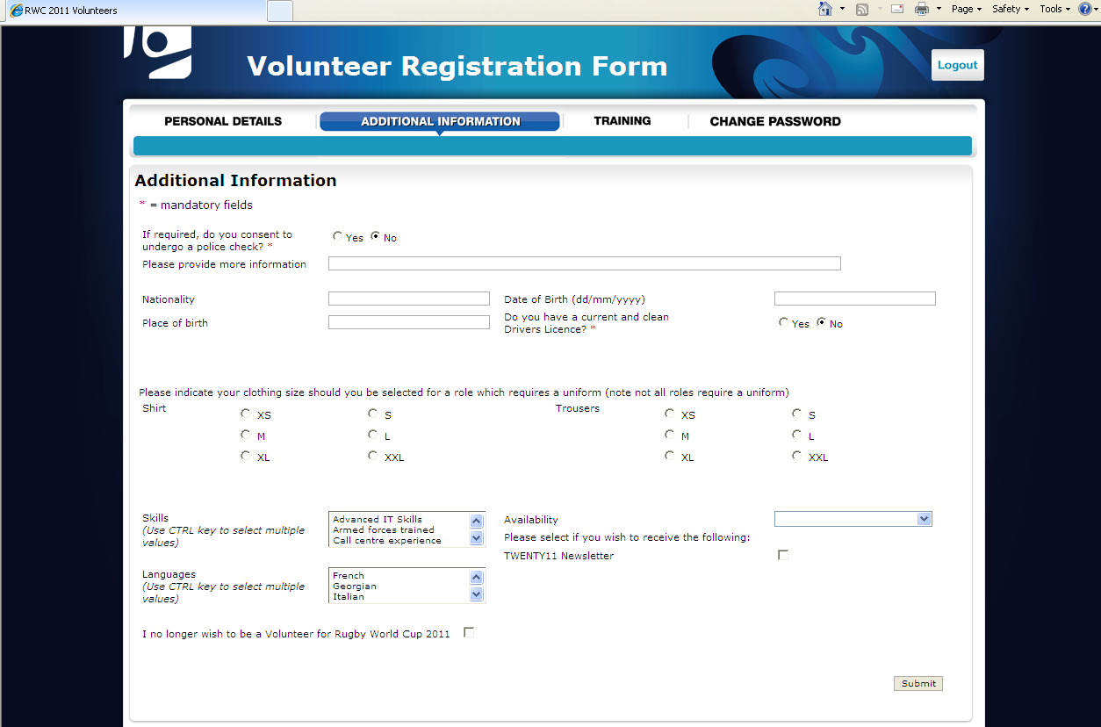

Slide 31
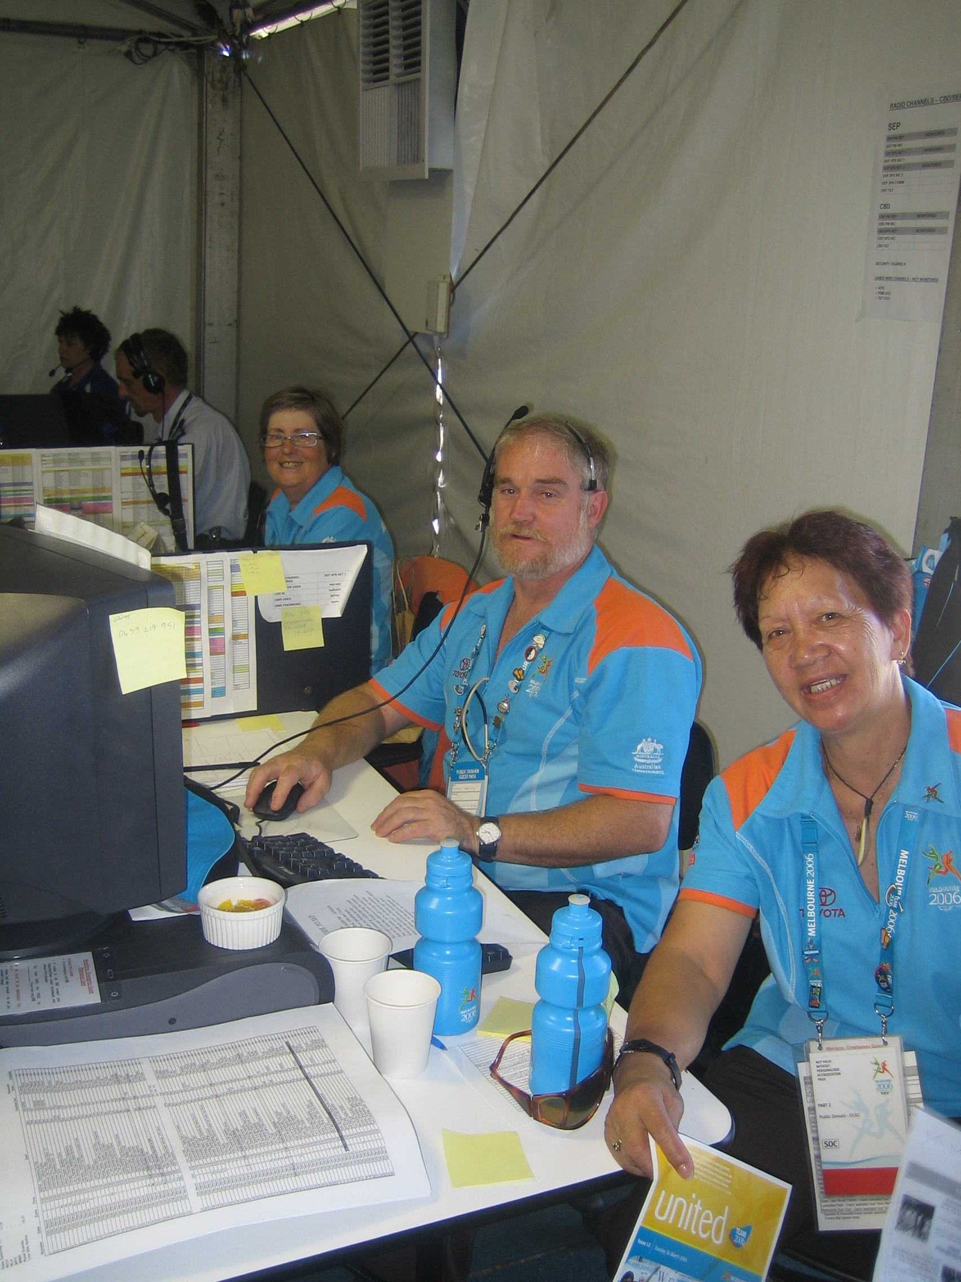
Registration steps
It’s easy!
Complete personal details
Select 3 areas of interest
Provide uniform sizes
Submit – Receive confirmation email

Slide 32
Next steps

Slide 33
For more information go to: www.rugbyworldcup.com/volunteer
To register go to...

Slide 35
Thanks for coming
Volunteer for other events at www.volunteernet.org.nz
Please register if you are serious about being part of the RWC 2011 workforce – we need you!
Notes:
Almost their ... Just 1 more video to show, then we’ll hand out the magnets and the RNZ 2011 Volunteer team will be here for about the next hour to answer any questions you might have – but please, keep it to questions!
Beijing Olympics exceeded people’s expectations – including their volunteers. However, expectation were low.
New Zealand has a great reputation for being great hosts and a clean green environment filled with adventure and wonder. The ability to exceed the expectations of visitors for RWC 2011 will depend on the attitude and behaviour of the volunteers.
Here is a promotion video from NZ 2011 Office – this is the way that New Zealand is being promoted overseas. It is another inspiring montage of the best that New Zealand has to offer. Thanks for coming!

Slide 37
TM © Rugby World Cup Limited 2008.

