Slide 1
Transport
1
Notes:
Welcome and thank you for your commitment and enthusiasm. It is a pleasure to have you on board the Transport team. You bring a wealth of Transport experiences and knowledge. It is important that we provide a Rugby World Cup service that is nationally consistent. You are p[art of the team putting the sport in Transport.

Slide 2
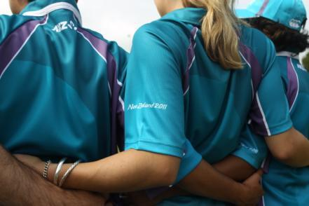
Welcome!
2
Notes:
Why are we here - define roles and responsibilities at tournament time , provide information to you and acknowledge the huge contribution you will make to this tournament
Purpose of the session – provide information and training , answer your questions , address any concerns.
What we will achieve by the end-
you will have the answers to your questions
more information on your duties and responsibilities at tournament time
Be really excited about your contribution to this event
Housekeeping – toilets , evacuations rules

Slide 3
Our Focus Today - Agenda
Welcome and overview
Rugby World Cup 2011, Team 2011 and Transport
Defining success for Transport
Transport roles and responsibilities
Fleet Centre Run Sheet Responsibilities
Scenario activities
Wrap-up
Notes:
3
Agenda – How we will go about the session

Slide 4
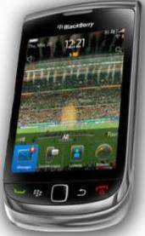
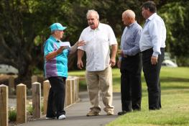
Making the most of our
time together
Notes:
4
How we’re going to work. Ground rules
What we put in is what we get out – the discussion we have at our table/s is really important
Timing is important. For each activity we will give you times, and we will have a break at XXXXX. We should finish by XXXX
- You have space in your traiing manual for notes. Be sure to write down any insights or questions!
- We will give you time for checking messages. Please turn your phones of.

Slide 5
Who’s Here?
Notes:
Who’s here activity – This exercise breaks the ice and allows attendees to identify other volunteers and the contributions they can make from past experience and learnings
Could be human bingo
Table discussion about previous experience in your FA

Slide 6
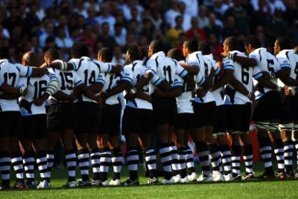
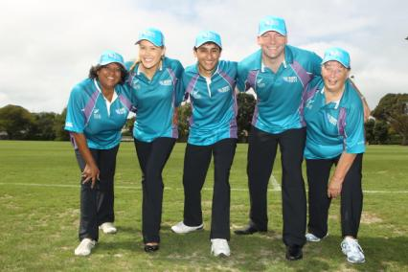
Who’s In The Line-up - Team 2011
6
Notes:
Talking points include:
Part of a bigger team making this amazing Tournament happen – Team 2011 ‘face of the Tournament’.
Introduce theme of wider workforce and stadium of 4 million
Delivering an operationally successful Tournament.
Customer excellence to an estimated 85, 000 visitors from over 125 countries.
An opportunity to show case our national rugby passion, our beautiful country, landscape, people and culture to the world.
6000+ people
The ‘face’ of the Tournament
A group like no other ever seen in New Zealand
Critical to the delivery of Rugby World Cup 2011!
Good transport will result in a happy tournament

Slide 7
Team 2011
7
Notes:
Overview of RWC 2011
IRB & RWC - structure layout (very quick reminder after online orientation)
Group discussion: What is the main function of each group?
Finish with Team 2011 – the face of the Tournament!
Provide overview of Team 2011 demographics
Quantity, spread around NZ, enthusiasm captured like no other event ever staged in New Zealand
Share two-three quotes from those who were the first to accept their role
Team Leaders within Team 2011 are a critical part of delivering a great Tournament, and helping Team 2011 have a fantastic experience
Team Leaders here include both paid and non-paid Team 2011 members

Slide 8
Understanding Our Functional Areas
At your tables, match the Functional Area names with the appropriate description.
Be as fast as you can!
8
Notes:
CARD SORT MATCH THE PHRASE TO THE FA
Explain that we may be asked a variety of questions from visitors and we may be required to direct them to other members of the wider Team2011.
Key point : Everyone needs to take ownership and provide a great customer experience “ open hands & hosting “ by understanding other areas roles at tournament time you will be able to assist or direct someone to key areas.
Tane how many functional areas are there ?

Slide 9
The Transport Team
Transport Coordinator
Fleet Coordinator
Fleet Operations Officer - Only AUK & WGTN Fleet Centre
Coach Drivers
Coach Load Zone Media Coach Load Zone
Team Drivers T1 VIP Drivers T2 VIP Drivers
Transport Manager
Travel Services Bureau
A&D Liaison Officer (AUK)
Transport Support & Roster Liaison Officer (WEL)
Fleet Communications Officer - Fleet Centre
9

Slide 10
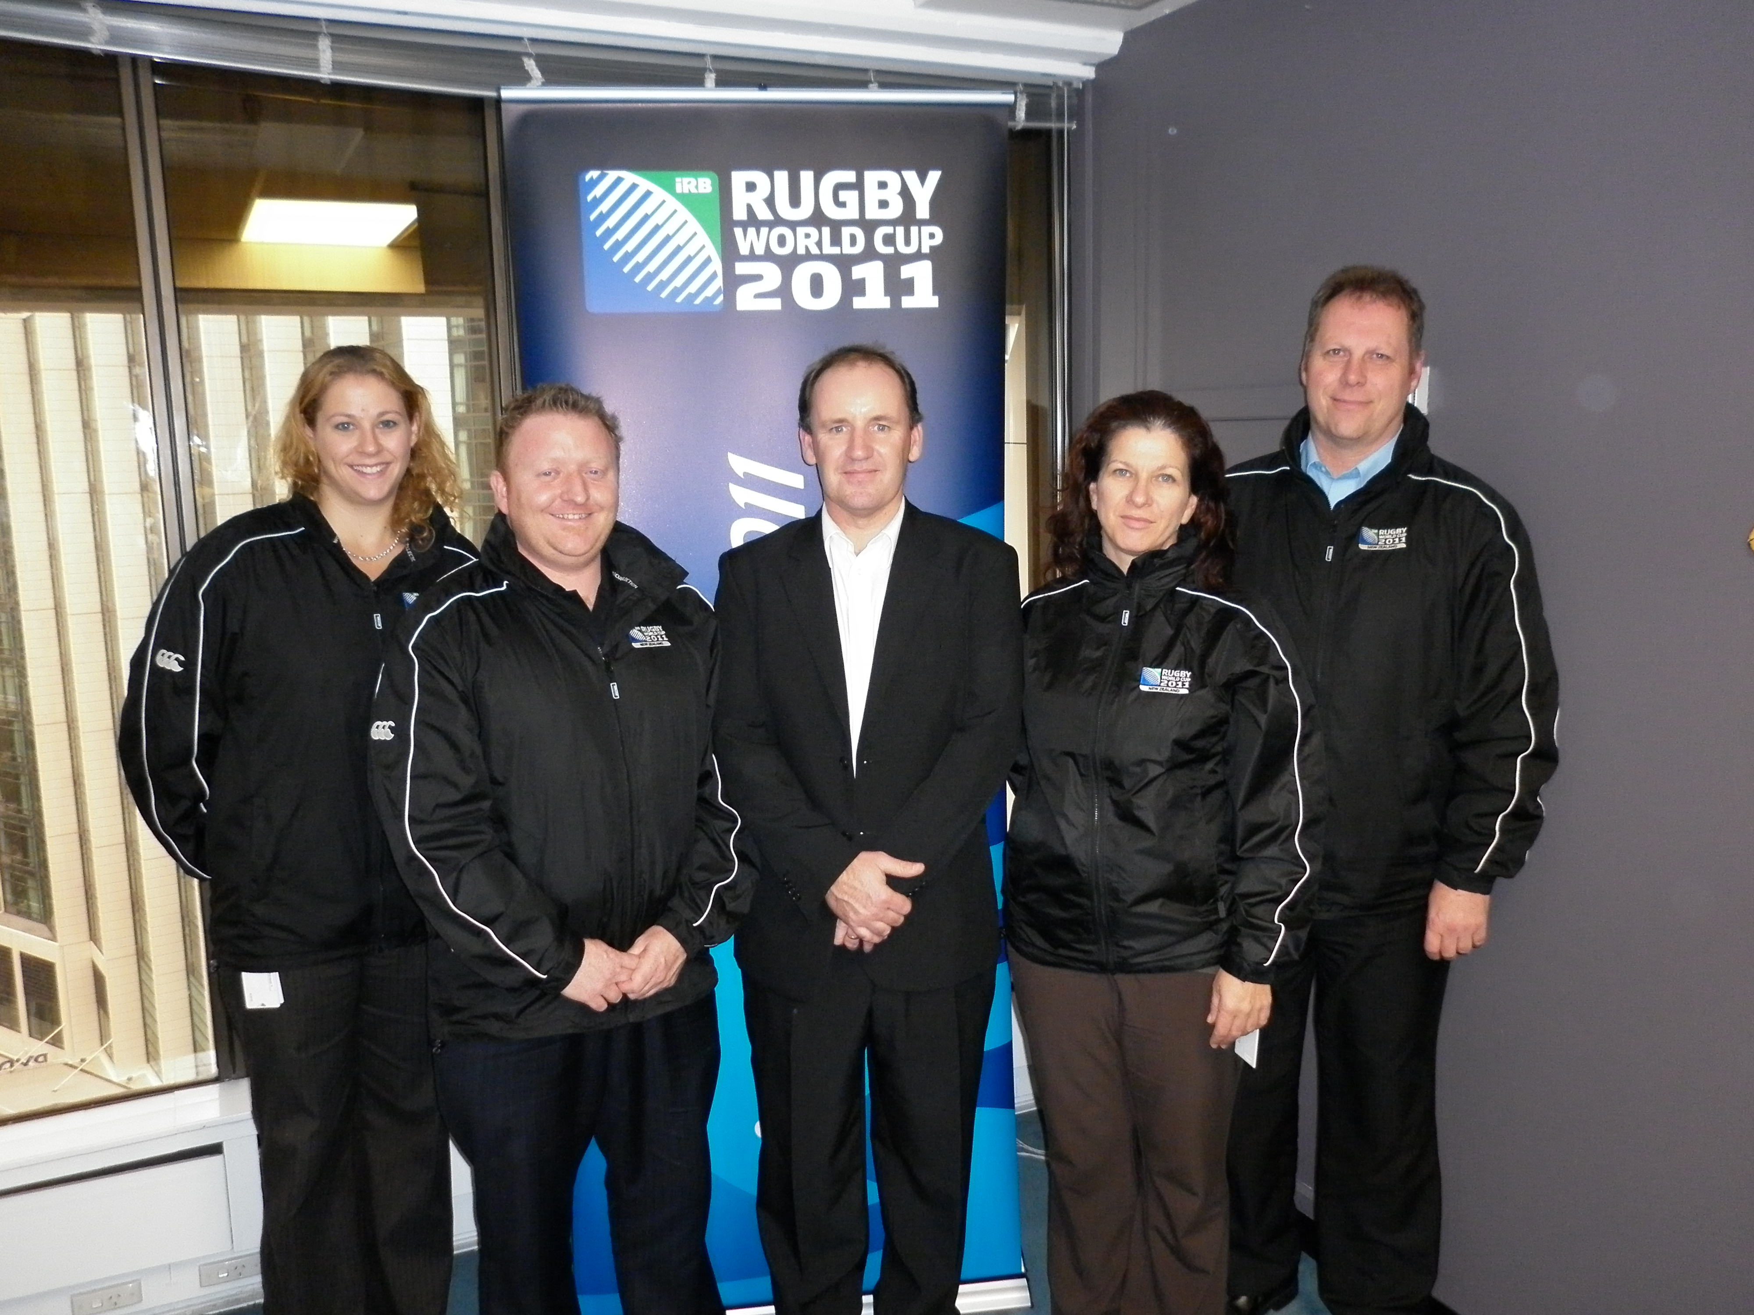
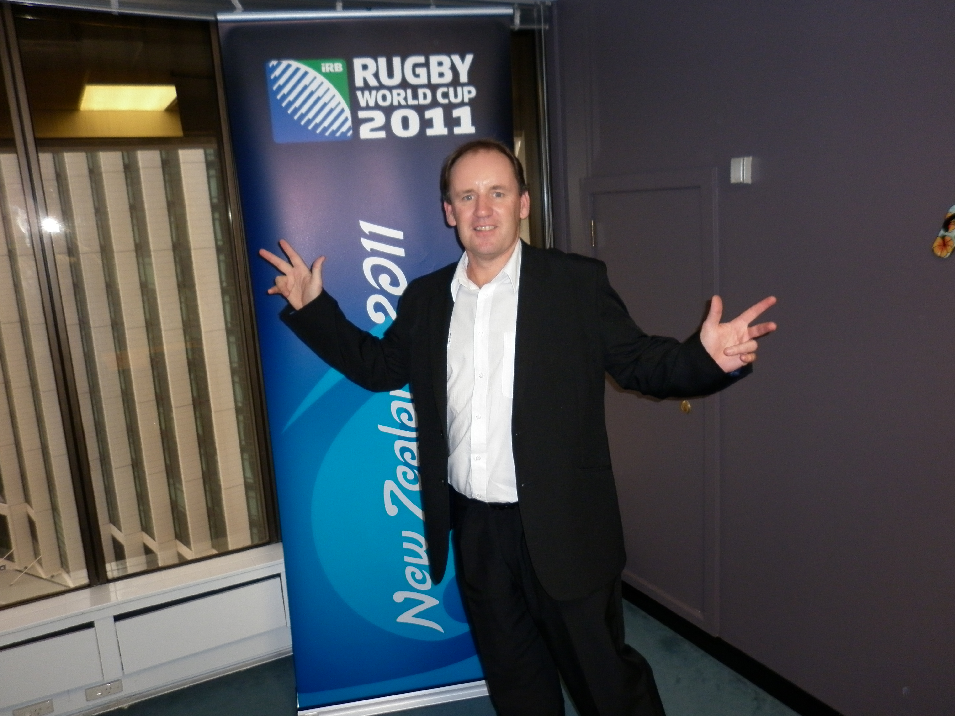
Transport Team – How we ‘fit’
10
Notes:
Talking points include:
The Transport programme will be delivered to the highest international standards.
Exceed our clients expectations
Set the benchmark for transport services in New Zealand
Expectations of RWC2011
Reporting and Communication flowchart
Rostering
Scheduling
Leave a legacy of well trained volunteers for the future

Slide 11
What We’re Aiming For - activity
Individually, write everything you think ‘success is’ for Transport
One word/phrase per post it note
Create as many post its as you can!
You have 90 seconds!
11
Notes:
Ask volunteers – put you hand up if you used public transport recently – what was the experience like in the train , bus or taxi ?
So what will success look like for the transport team at tournament time ?
After 2-3 minutes, get each table to stick all their post it notes on a wall, then as groups (or just one if a small group)
they discuss common themes emerging
Their task is to ‘cluster’ all their post it notes into themes, then agree a sentence that uses the words/themes

Slide 12
Transport Roles and Responsibilities
At your tables, match the Transport roles with the descriptions.
Discuss how they’re different, and how we rely on all roles for a seamless Transport experience.
12
Notes:
Card sort
Everyone will have a role to play ...
Sometimes it will be dependent on workloads .
However we all need to understand the roles and the dependencies and work together as a team

Slide 13
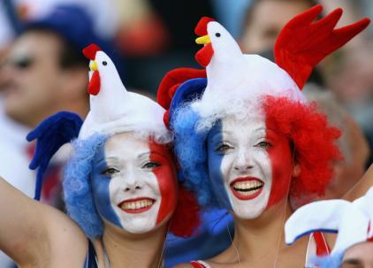
BREAK
13
Notes:
This might be when you have your venue tour...
State how long break is for and when recommencing

Slide 14
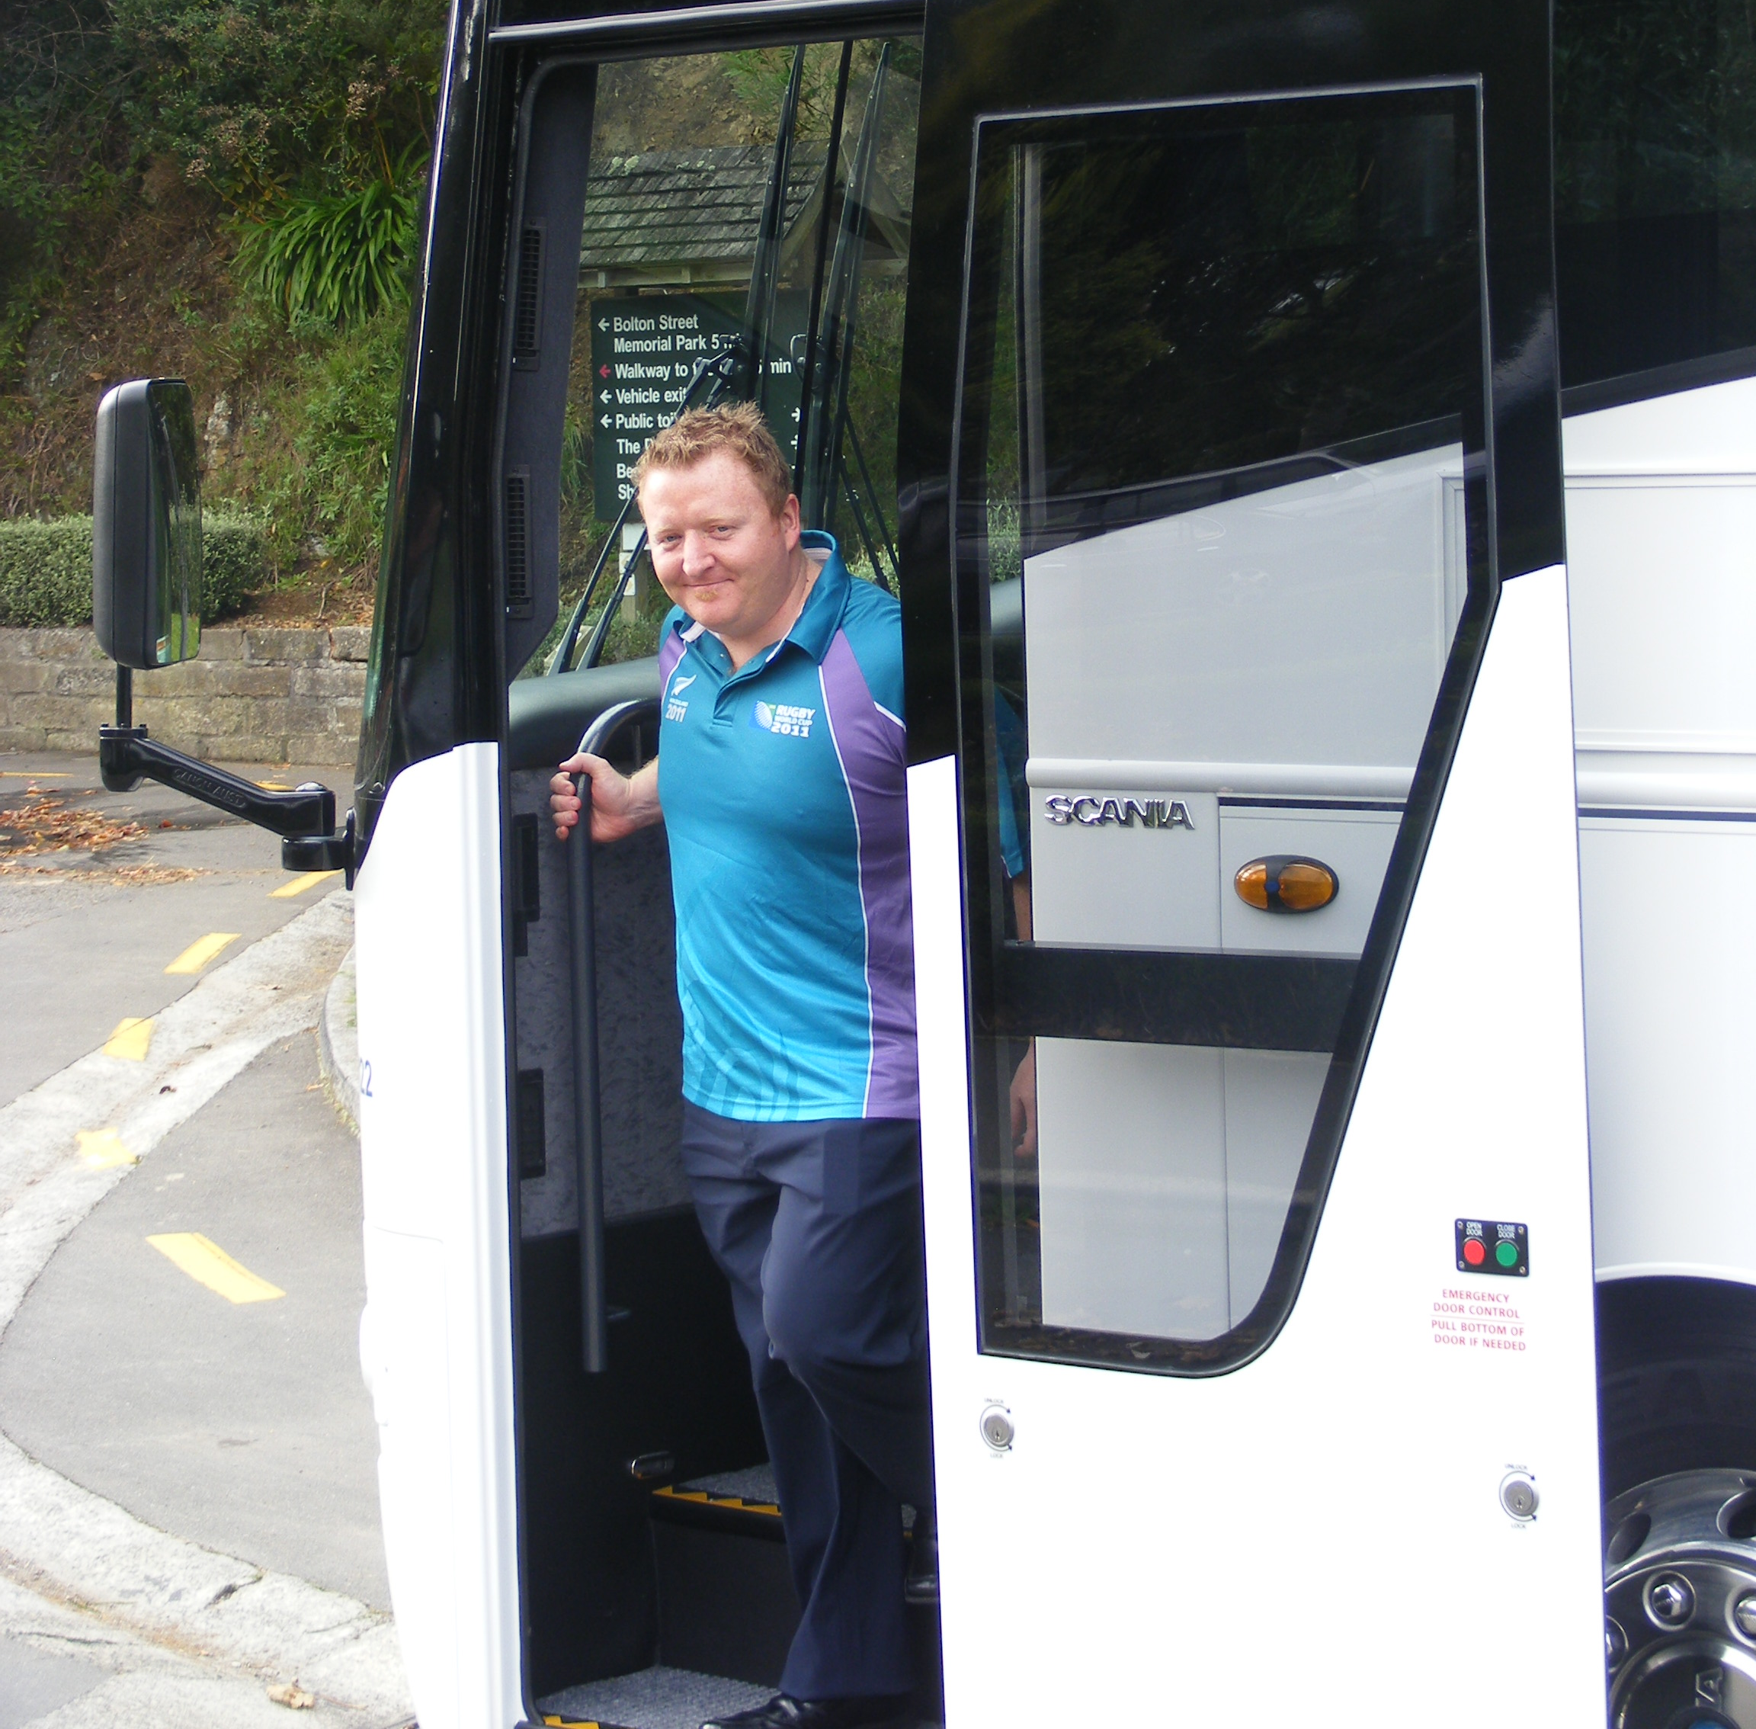
Scenarios
14

Slide 15
Scenario 1 – Group Activity
A T1 Driver phones into the Fleet Centre, the driver is stuck in very slow moving traffic on the way to collect the passenger from the airport; there may be an accident up ahead, the driver is not sure what is causing the delay.
The driver is due to be at the airport and staged in five minutes according to the schedule, but thinks it could be up to thirty minutes at the current rate of travel. The driver left on time from the Fleet Centre.
15

Slide 16
Scenario 1 - Questions
Who would you expect to be fielding this phone call from the driver?
What information will the Fleet Communications Officer or Fleet Coordinator need to consider?
What options will need to be considered to come up with a plan B should the driver continue to run late due to the traffic condition?

Slide 17
Scenario 1 – Answers
The first contact point is the Fleet Communications Officer.
This role will be taking calls relating to drivers, the drivers destination, despatches or any issues the driver may be experiencing.
Speak to the Fleet Coordinator if the Fleet Communications Officer is not available.
17
Notes:
Answers to scenario 1;
Prompt group for answers: Who would you expect to be fielding this phone call from the driver.

Slide 18
Scenario 1 – Answers (cont.)
Check the driver schedules and itineraries to determine if there is another vehicle and driver that will be clearing at the airport shortly to meet the incoming passenger.
There may be a need to organise a taxi if there is no one available to cover.
18
Notes:
Answers to scenario 1;
Prompt group for answers: What information will the Fleet Communications Officer or Fleet Coordinator need to consider?

Slide 19
Scenario 1 – Answers (cont.)
Is the flight running to schedule?
Find out why the delay has occurred?
Investigate the cause of the traffic issue and use resources available (internet) to check traffic camera links, AA website, Police communications website e.t.c.
19
Notes:
Answers to scenario 1;
Prompt group for answers: What options will need to be considered to come up with a plan B should the driver continue to run late due to the traffic condition?

Slide 20
Scenarios 2 – Role-play
A driver is completing the pre-deployment checks on the allocated vehicle as part of the start of the first shifts processes and procedures.
The driver is half way through the check and finds that the left rear indicator is not working. The first job indicates that the driver needs to leave the Fleet Centre in fifteen minutes
20

Slide 21
Scenario 3 – Role-play
A driver calls into the Fleet Centre very distressed that they have been involved in a car accident.
The driver and passenger are both ok and uninjured, however the vehicle is badly damaged and they were heading to the match but are unable to continue now that this has happened.
21

Slide 22
Questions
22

Slide 23
Hosting the Rugby World Cup 2011
23

Slide 24
24

