Slide 1
Captain’s Run

Slide 3
Captain’s Run

Slide 4
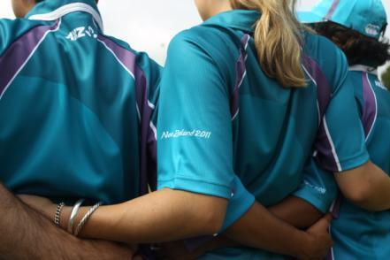
Welcome!
Notes:
Mihi
Welcome, and thank you for your commitment, enthusiasm and time . It’s great to see us all come together with less than two weeks before the first game of RWC 2011. Right Here.....
Are we Ready!?
Thank-you for your commitment to reach the captains run our final destination before RWC 2011. You all bring wealth of experience, knowledge and passion to the team. For some of us you may have just got on board. I welcome you to the team.
You will have an experience of a like no other. The Rugby World Cup is the third biggest sporting event in the world, with an expected 100,000 visitors from a 127 different countries expected to visit New Zealand during the Tournament.
You are a critical part of Tournament delivery. You are the face of the Tournament. We will energise and inspire people to have a memorable experience while setting the bench mark for hosting the Rugby World Cup and showcasing our region and country.

Slide 5
Our Focus Today - Agenda
Welcome!
Why we’re here
People to meet
Staying safe
Our work venue!
Notes:
5
The purpose of the captains run is to ensure we are all fully prepared for our first shift. It is an opportunity to familiarise yourself with your working environment and who you may be working alongside. This is a chance to ask your functional area manager or team leader any questions you may have. So on your first shift you will know exactly where to check-in and what is expected of you during your shift.
House keeping -
Structure for today
There are two parts to this session. The second session will lead by your Functional Area Manager
During the first session you will meet our Match Manager, Team and Guest Speaker.
You will gain an understanding of how to help keep you, your team mates and the public safe during each match.
You will also gain an understanding of accreditation processes and learn some vital information to ensure your are prepared for your first shift
After a 10 minute break you will move into your functional area for the venue tour and functional area specific content lead by your Functional Area Manager.
I would now like to introduce you to our Match Manager –
There is an enormous amount of preparation and logistics involved in delivering a Tournament like Rugby World Cup 2011.
At each stadium, we have a Match Manager who is responsible for ensuring all the jig-saw pieces come together. Lets put our hands together for our MM...

Slide 6
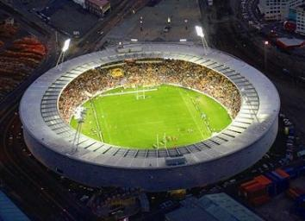
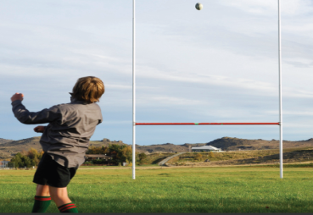
Match Manager Kate Bidwell
Notes:
The Match Manager introduces their team (FA Managers) and outlines their role and vision for games played at the Match Venue.
The Match Manager introduce the Guest Speaker.

Slide 7
FIRSTLY THANK YOU!!!!!
T – TOGETHER
E – EVERYONE
A – ACHIEVES
M - MORE

Slide 8
MATCH MANAGERS ROLE
So what do I do?
And how do you help me?

Slide 9
LET ME INTRODUCE THE SUPER STAR RNZ 2011 TEAM!
WHAT DO THEY DO?
Media – Janine Stutz & Nick Maybury
Catering – Matt Spiller
Match Services– Kate Bidwell & Derek Dingle
Spectator Services – Theresa Cayley
Logistics – Brett Kennerley & Allen Butt
Workforce – Trish Ross

Slide 10
TOP 5 THINGS TO REMEMBER BEFORE YOUR SHIFT ☺
1) Your personal ACCREDITATION
Without your accreditation you will not be able to get into the stadium. If you can’t get into the stadium then you can’t do your RWC 2011 shift.
TREAT YOUR ACCREDITATION LIKE YOUR PASSPORT. DON’T FORGET IT ☺

Slide 11
2) VOLUNTEER TRANSPORT
Free travel on the public transport System (Buses)
5th Sept to 27th Sept inclusive How: - Wearing your uniform - Presentation of Accreditation
Free parking in the Downtown car park
5th Sept to 27th Sept, inclusive
Volunteer only shuttle bus (match days)
1 x bus to pick up volunteers at Downtown Car Park 1 hour prior to gate opening
1 x bus to pick up volunteers on Tukupa Street 1 hour post game to Downtown car park

Slide 12
PUBLIC TRANSPORT
Shuttle Bus Service (Match Day Only) - Ariki Street to Stadium Taranaki - Gold Coin Donation – each way
District Bus Service (Match Day Only)
Services from the following areas ; - Urenui, Waitara, Bell Block, Oakura, Stratford, Inglewood, Hawera & Opunake
- Return services to each area post game until 9.30pm
- Children Under 5 travel free - Family packages available = 2 adults and up to 4children
Current Urban Bus Routes (Match Day Only)
Charge for each bus journey leaving CBD on all urban routes (9) will be gold coin donation. Running until 10.30pm post game

Slide 13
3) Workforce Check In
Spotswood Gym
4) Uniform
5) SMILE & don’t be afraid to ask questions
Many foreign visitors so lets make them love Taranaki!

Slide 14
Finally something you would not know about me...........
I was a volunteer once too ☺
Enjoy this experience!
This is once in a lifetime

Slide 15
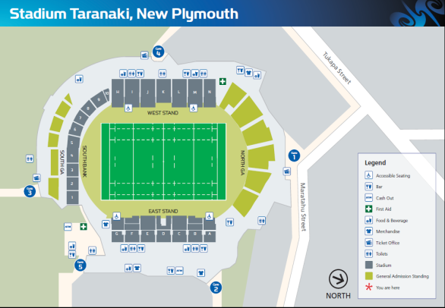
Our Stadium Jude Cleland
Notes:
We are all responsible for keeping each other and the public safe during the Tournament. I would like to introduce XXXX who is going to provide you with a venue specific briefing which includes health and safety, evacuation procedures and Public first aid.
Please put your hands together for Keith Parker.
After briefing
Based on what you have heard. I want you to talk to the people around you to discuss how you’d deal with each scenario I give you. You have 30 seconds
There is a fire in the stadium
Water is flooding from the toilets
A man has collapsed in front of you
Members of the public are slipping and sliding down the stairs
The beer is not cold
If you have any questions around any of these scenarios. Please bring these up with your functional area manager. It is important that you feel confident to be able to deal with any situation you are faced with. Remember to stay calm.

Slide 17
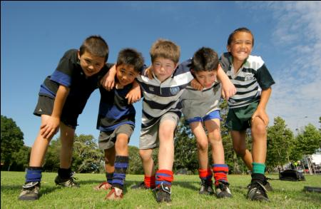
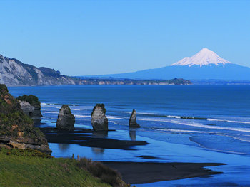
Harry Duynhoven
Notes:
The Match Manager and MC thank the Guest Speaker
Highlight any insights
Conclude - these sessions are happening all around New Zealand to ensure that their is a national consistency around the country. We are fortunate to have 6000 Team 2011 representatives and a stadium of 4 million who are all passionate and committed to providing a great experience to all those involved.
Each interaction we have could be the difference in providing that spark in someone’s experience in your region and New Zealand.

Slide 18
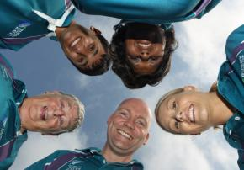
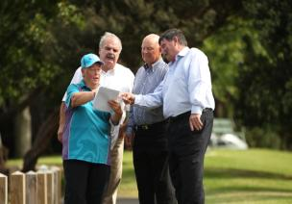
Regional Workforce Manager Trish Ross
Notes:
I would like to introduce you to our Regional Workforce Manager for an overview of how to prepare for your first shift.
Please put your hands together for their amazing job they’ve done in preparing us all for our first shift.

Slide 19
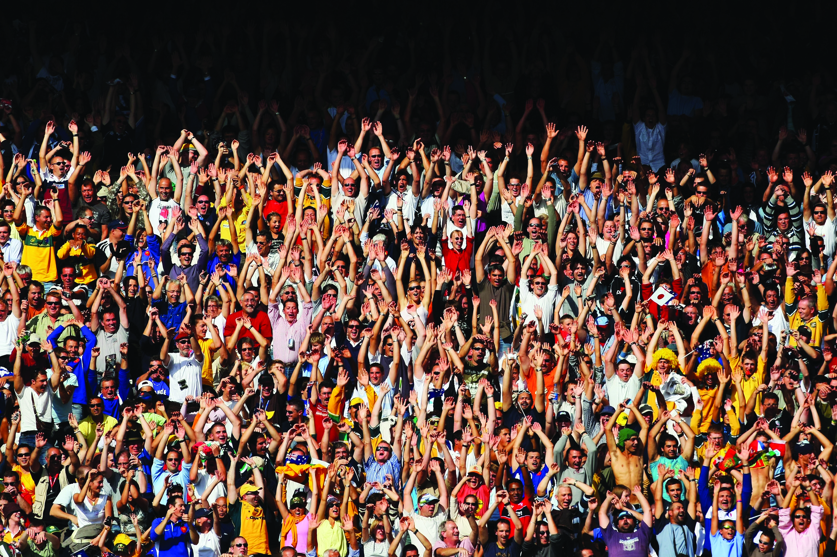
The Workforce Squad...
the force behind the scrum
Uniform policy
Code of Conduct
Team 2011 well being
Workforce check-in
Workforce catering
Transport for Team 2011
Team 2011 welcome event
Notes:
We’re here to support you...
At the end of the Regional Workforce Managers overview the Match Manager provides an overview of session 2
Introducing each FA Manager and outlining where each FA will meet before their tour

Slide 20
Where to go after the break....
....but first...
Notes:
We’re here to support you...
At the end of the Regional Workforce Managers overview the Match Manager provides an overview of session 2
Introducing each FA Manager and outlining where each FA will meet before their tour

Slide 21
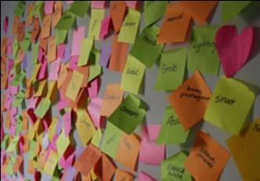
Let’s Get Talking!
Blue – What I’m most excited about
Purple – What we want our visitors thinking / feeling when they leave THIS stadium
Yellow – A message to other Team 2011 people around New Zealand!
Notes:
After 2-3 minutes, get each table to stick all their post it notes on a wall

Slide 22
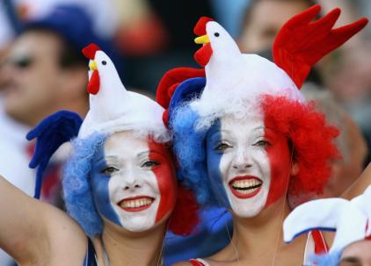
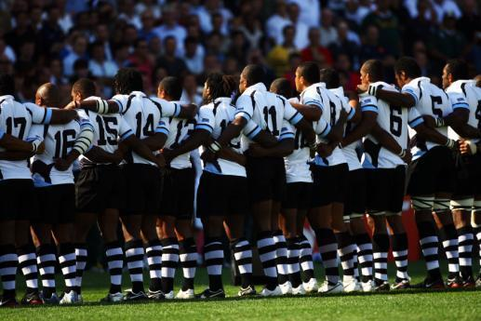
BREAK

Slide 23
SPOTSWOOD VISIT
Workforce Check IN & Break Area visit

Slide 24
Captain’s Run

