Slide 1
National Partner Strengthen & Adapt programme
National programme evaluation Year 3:
SUMMARY PRESENTATION
Dec 2024 and Updated Feb 2025
Notes:
This deck includes key slides and summary slides from the full presentation of S&A evaluation findings for Year 3.

Slide 2
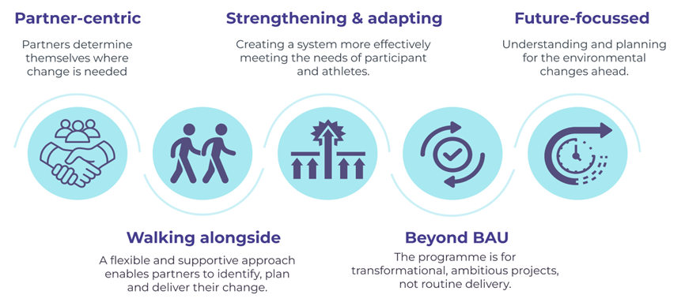
The S&A programme principles remain constant
Notes:
S&A was part of the government’s COVID-19 Recovery Package ($265m funding over four years from 2020). National Partners presented business cases to secure some of the investment available to strengthen and adapt in a way that they felt best positioned their organisation, networks, and the communities they served to ensure their long-term viability and sustainability. The Recovery Package was not intended to fund the development of physical infrastructure or new facilities nor campaigns to increase physical activity or ‘business-as-usual’ activity.
The heart of the S&A has remained constant through evolving delivery and across the range of Partners and projects. These principles were identified in earlier phases of the evaluation. The purpose of the S&A programme is to build the capacity, capability, and resilience of investment of Partner organisations and their delivery networks, so that they are best positioned to meet the needs of participants and athletes into the future. The programme operates in the spirit of partnership and according to the principles on the slide. These principles combine to give the programme a unique kaupapa and approach that has been valued by Partners.

Slide 3
The S&A programme and Year 3 evaluation focus
Notes:
This year’s report focusses on the change projects of Waves 1 and 2. These are the largest Waves, both in terms of numbers and financial investment (81% of all project funding). This report essentially begins to test the programme logic developed for S&A. It explores the success of completed change projects and their contribution to the intended S&A programme outcome areas.
This is our third and penultimate annual evaluation report for Sport New Zealand’s (Sport NZ) National Strengthen & Adapt Programme (S&A or the S&A programme). This report is written primarily for the Programme Team and their internal sponsor.

Slide 4
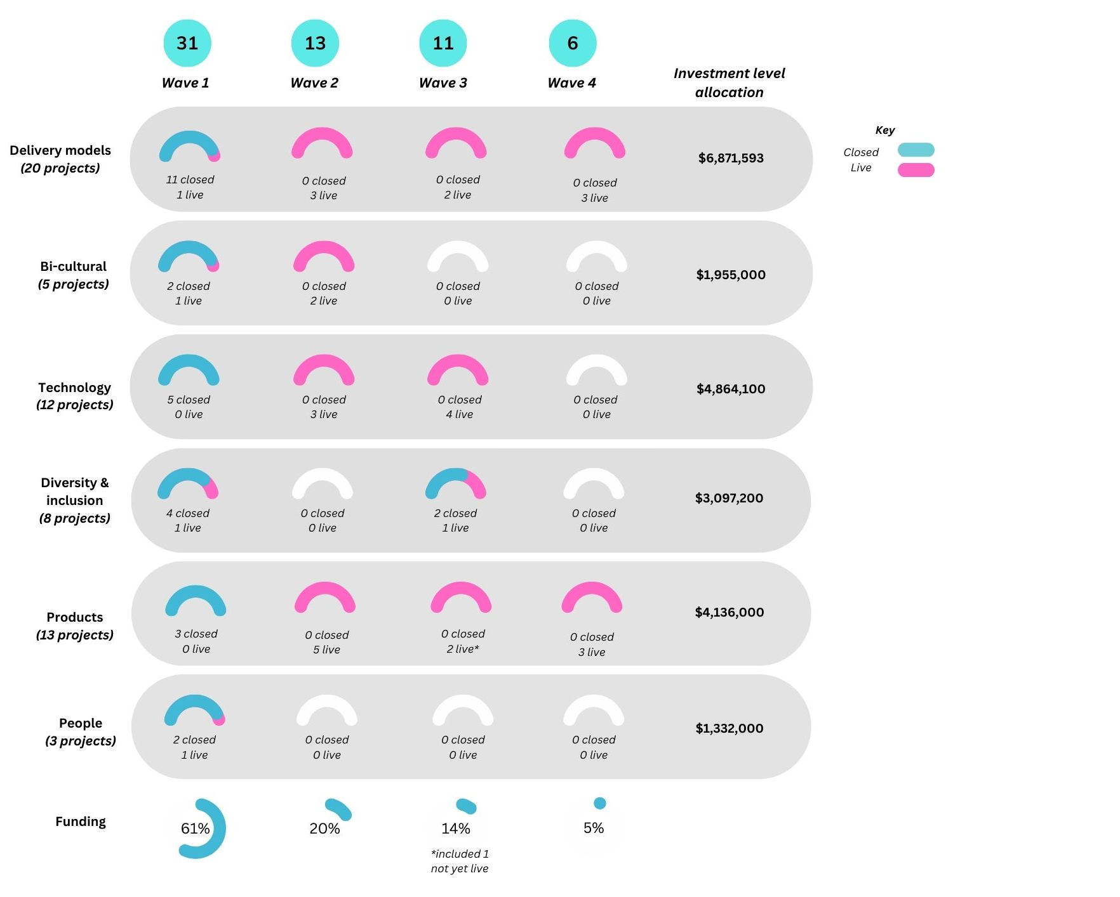
Investment across Waves and programme areas
Summary
W1 and W2 represent 81% of funding. From an investment perspective 27 of these44 projects are closed
(September ’24)
$22,255,893
Notes:
Handout of this image is recommended as font too small to read
This year’s report focusses on the change projects of Waves 1 and 2. These are the largest Waves (21 Partners) and represent 81% of the total funding allocated to Partners.
Total 61 change projects with $ 22,255,893. The Wave 4 Partner not yet live is Softball- dashboard identifies the schedule still in draft
How many projects are ‘finished’? 27 of 44 are closed on the investment dashboard.
CLOSED means the investment period is closed. Some of these projects are still active (Basketball and Netball)
LIVE means there is still funding to be released.
NOTE The investment dashboard and classification of some projects was recalibrated in Oct 2024 so exact project counts may have changed since this report was prepared

Slide 5
Progress against project outcomes:
W1 & W2 Change projects have achieved or are progressing towards the project outcomes
Project status at Sept ’24:
27 Closed
17 Live
Notes:
How far along are the live change projects? The 17 live projects (investment period is open) are progressing towards the outcomes identified in their M&E plans.
Some of the closed projects are still progressing towards their intended outcomes e.g. close to the tipping point that will see outcomes achieved such as Basketball's new two-tier structure on track for go live in 2025. Some closed projects have only achieved some of what was intended, and they may or may not progress further (Guides and the Y)
What changes are Partners reporting in their M+E Plan outcomes? Of all 44 change projects belonging to W1 and 2 Partners, 20 have achieved the outcomes identified on their M&E plan fully, or to a reasonable extent, 21 are progressing towards them and only 3 have made partial progress.. Summaries of the high-level changes are on this slide

Slide 6
S&A adds value beyond what was envisaged
“From a digital perspective, certainly [S&A] has allowed us organisationally to think from a more data led perspective, because we've come from a very manual way of doing things across the system - across all of our business units - and not really thinking more deeply around some of the analysis points.“ Partner
“So, I'm quite proud of we we've got to now, and [using participant activity data] for understanding who they are, where they're coming from, what they're motivators are to come to a game to help drive the strategy for the next season. “ Partner
New, better, different and deeper relationships across Partners’ networks
Using data more for insights and learning than before
Learning about organisational change
These connections and support were the most valued
  Team and NPMs connecting people
  Tech and change management support and the original discovery work
  1:1 project support and coaching
Limiting factors
  All Partners/projects are unique
  As the initial cohort, W1 Partners’ feedback informed and enabled improvements in S&A programme delivery for subsequent waves
Notes:
Are Partners identifying any other outcomes as a result of S&A? Yes, in term so of increased networks, learning about using data for evidence based decisions and reporting and learning about change management.
What have Partners learnt through their change projects? Underestimating the time required, needing to have and work through people etc. These are typical aspects of organisational change and have been expressed in previous evaluation reports. The section on project outcomes also identified learnings that are specific to change project themes.
What impact has S&A had on networking and relationships? Positive with Partners valuing it and reporting that S&A has required more engagement across their organisations to get ready for, and deliver, S&A change projects. Personal connections rather than organisation to organisation relationships have been created. Platforms re aquatics, rowing and parasports have been created emerged through S&A work.
Has S&A built the capability of the sector? Yes – measurable stronger and more resilient – through change projects and networks and capability building. Even if people don’t stay in role/org they often stay in the sector and the investment will add value. W1 Partners helped identify the support required with projects. Partners said a clear list of resources available would have been/still be helpful.

Slide 7
Creating a learning environment: Sport NZ walk the talk
Summary
“They give Partners the space to be able to do the things they need to do, whilst recognising that lots of these Partners, … .we don't have lots of personnel resource to be able to do particular things … We don't have masses of money to hire extra people, you know, BAU still happens. So, the space and the ability they've given us to be able to just get on and do things in the way that we know works for our community. They often talk about nationally led locally delivered [and] I do feel that actually Sport NZ really walk that talk down to their Partners as well. … there was that flexibility to try different things, and I think that's one of the things that Sport NZ are really good at. “ Partner
Notes:
Strong theme in interview feedback was how well supported by Sport NZ Partners felt on their change journeys. As one said, “It's not so much about have you failed or succeeded, but what have you learned?”. Partners felt they could discuss challenges openly. Having 1:1 support from the programme lead and their NPMs and other SME was key to this.

Slide 8
The S&A programme’s short-term outcomes
Outcome domain changes expected by sub domain
Strategy and leadership Strategy (activities/opportunities) is future focused and participant-centred Improved alignment of resource (people/time) to strategy (capacity)
People Improved diversity and quality of Partner network workforce Improved engagement of Partner network workforce
Systems, policies and processes Improved organisational systems, policies, and processes in place to be more resilient Improved organisational systems, policies, and processes in place to deliver strategy Improved processes and plans to address historical inequities, inclusion and diversity gaps in the system
Structure Aligned governance structures to deliver on strategy (functionally set up to make decisions) Improved and aligned delivery structure models (strategy is reflected at local level and informed by local level
Highly developed
Consolidating
Developing
Emerging
Emerging
Standards of performance
Notes:
The intervention logic identifies that increases in these four domains and nine subdomains of organisational functioning as the way short term programme success will be identified. The more high-functioning these domains are, the stronger and more resilient to future change, Partner organisations will be.
As part of their interview, Partners completed a survey about these domains, creating a baseline (pre-S&A) and current rating, and discussing what had changed and what had contributed to the change. Partners only rated subdomains directly related to their change project (identified by Sport NZ).

Slide 9
Improvement across all short-term outcomes
Partners rated and described improvements in all subdomains of organisational functioning.
S&A made a strong contribution towards all the changes described - directly and indirectly. The strongest contribution was in terms of workforce and network engagement.
Other organisation, business, sector and societal factors contributed to these improvements and will be supportive factors post programme.
Notes:
The subdomain scores illustrated on the chart in slide 32 have been used to create a single overall score for each of the four outcomes domains for the S&A programme.
Mean increase across S&A outcome domains. Baseline compared with Sept 2024 (n=69 ratings from 15 partners).

Slide 10
Sustaining the gains of change projects by transitioning to BAU
The success of the Girls Activation Programme has highlighted the importance of providing fit for purpose and locally designed programmes that meet the needs of girls and young women wanting to access to rugby. As a result, the Provincial Unions through their Strategic Alignment Funding (circa $2M allocated for W&G Community Rugby in 2024), are now investing in more activator capability and programmes to support more entry level access to rugby and this has now been folded into NZ Rugby's Community Rugby Strategy for 2026-2030. [ reporting]
Closed completed projects have already transitioned to BAU
  Some transitions are supported by successful commercialisation and ongoing organisational backing
  Transition was planned in advance and projects were designed to be sustained
Other projects expect to be able to transition to BAU
  These Partners yet to confirm funding in this tight fiscal environment.
Only a minority of Partners expressed severe concern about transition to BAU once S&A investment is complete
Notes:
Are the S&A outcomes sustainable? Mostly, with some more sustainable than others. Some change project outcomes represent a step change or ‘hardware’ change that will continue to exist and deliver benefits. People, capability, behaviors etc., are more like ‘software’ and these soft elements of change will be sustainable but will need future/ongoing investment as there is natural turnover of staff etc.
Partners who expect to sustain ongoing operational costs of change projects were mindful of the tight fiscal environment but were generally hopeful of securing funding as the S&A period had provided the opportunity to make significant changes and understand the benefit they brought.
Smaller organisations where funding for roles is required are potentially the most vulnerable. Needing to secure funding on an annual basis was also raised as a challenge to long term planning that also used up resource to secure each year.

