Slide 1
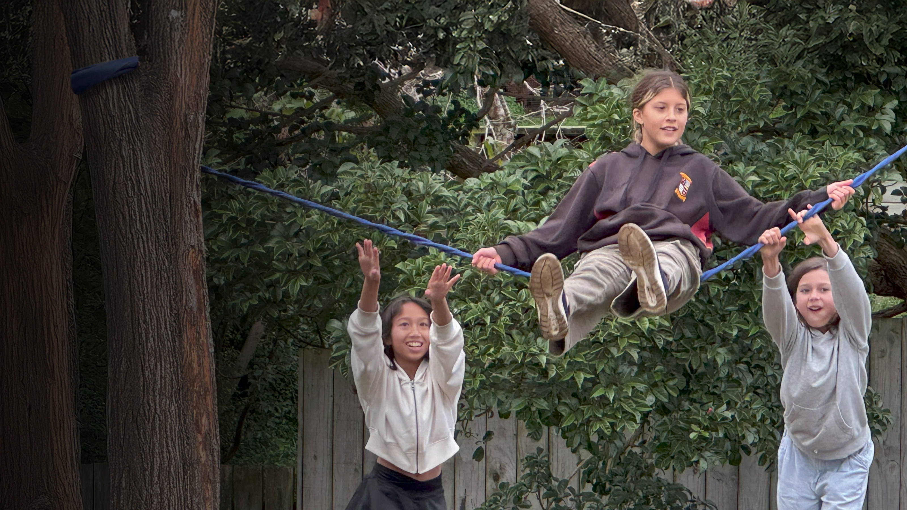

Value of Play

Slide 2
Play is more than just having fun
It helps tamariki learn, grow, connect, contributing to healthier lives, stronger communities and better outcomes across health, education and wellbeing.

Slide 3




The evidence points to 4 key areas
Play contributes to a child’s:
1.
Health and wellbeing
2.
Learning and development
3.
Social connection and belonging
4.
Cultural identity and wellbeing
Through play, tamariki build relationships, confidence, skills and a sense of belonging that can strengthen whānau, schools, kura and communities.

Slide 4
Play supports health and wellbeing
Evidence shows play supports:
physical activity
movement skill development
mental wellbeing
confidence and resilience
healthier sleep.
Play is a low-cost way
to support both physical and mental wellbeing.
Evidence spotlight
Research found no evidence of increased rates of serious injuries when tamariki are allowed to take controlled risks in play. These experiences can help tamariki build confidence, assess risk and develop resilience.

Slide 5
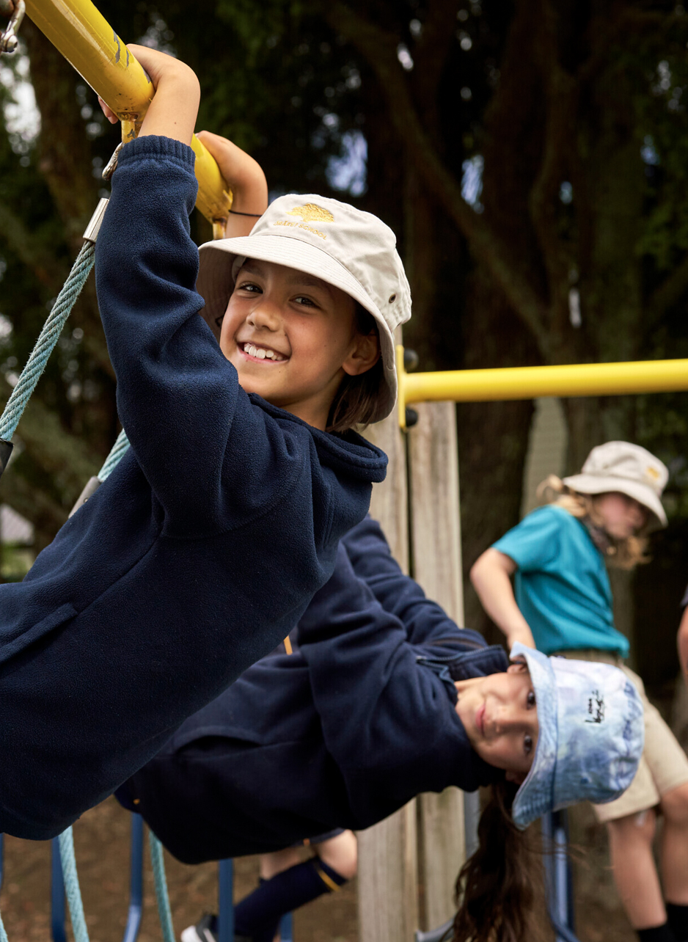
Play supports learning and development
Evidence links play and movement with:
improved classroom engagement
better attention and memory
improved learning behaviours
positive educational outcomes.
Play and learning work hand in hand.

Slide 6
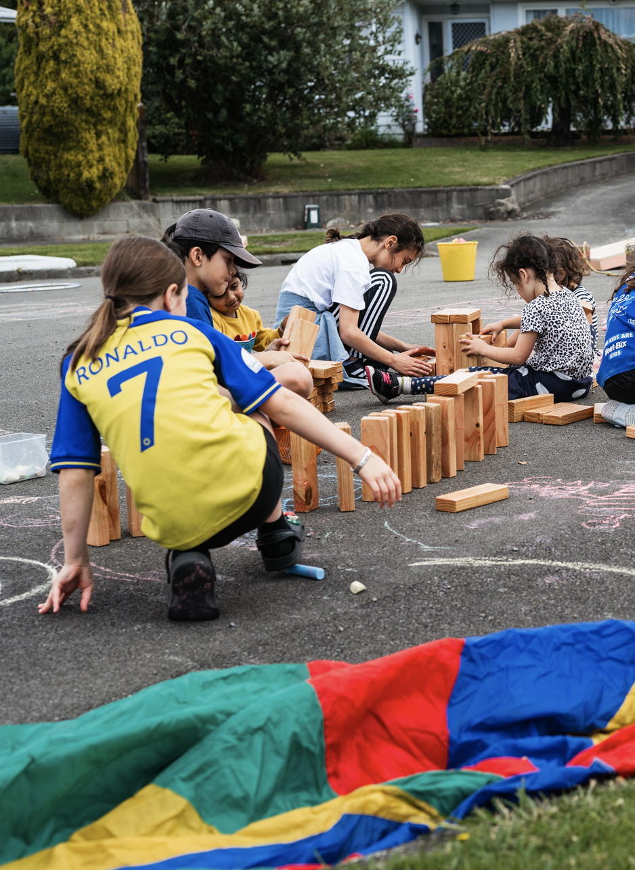
Play builds social connection and belonging
Play supports:
friendships and peer relationships
social skills and empathy
whānau and community connections
a stronger sense of belonging.
These foundations help tamariki
build positive relationships throughout
life and contribute to more connected communities.

Slide 7
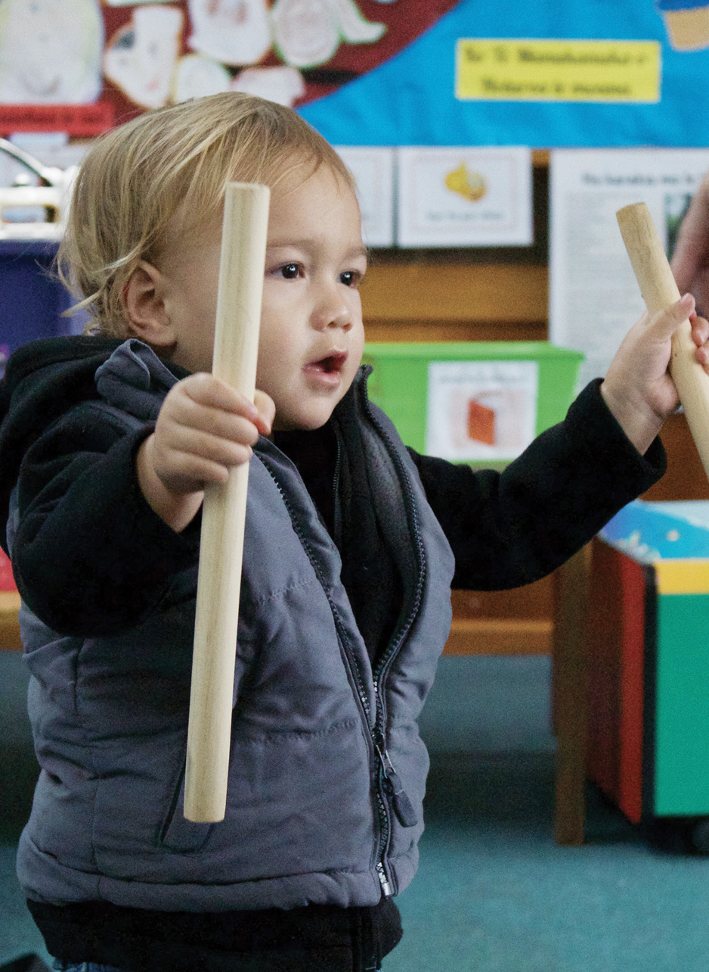
Play strengthens cultural identity
Play can:
strengthen cultural identity
support language and cultural knowledge
build connections to people and place
foster belonging and community connection.
Play is a powerful way to
strengthen identity and culture.

Slide 8






Tamariki lead play. Adults make it possible.
Opportunities for tamariki to play are influenced by decisions about:
Time
Space
Access
Planning
Funding
Policy

Slide 9
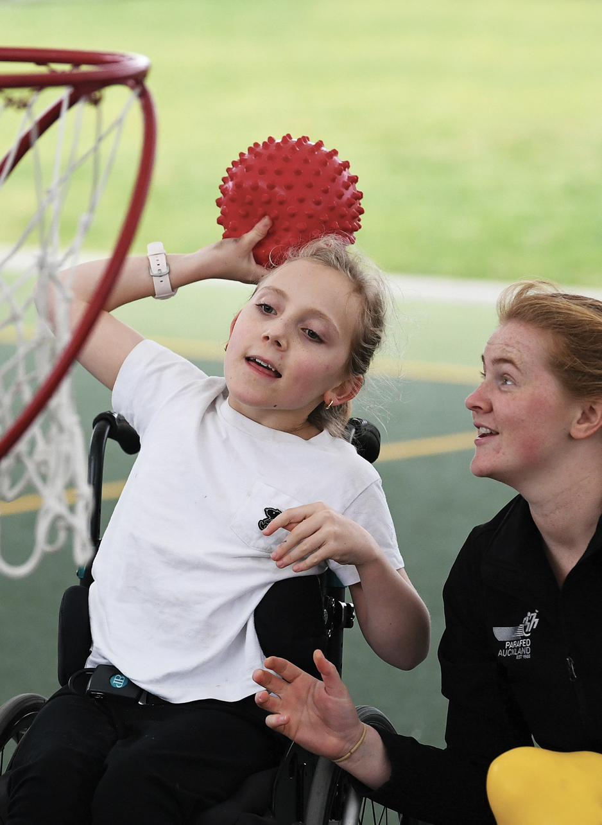
Everyone helps create the conditions for play
Creating opportunities for play requires action
across sectors.
We all share this responsibility:
central government
local government
schools and kura
health organisations
community organisations
play, active recreation and sport organisations.
Together, we can make quality play
easier to access for all tamariki.

Slide 10
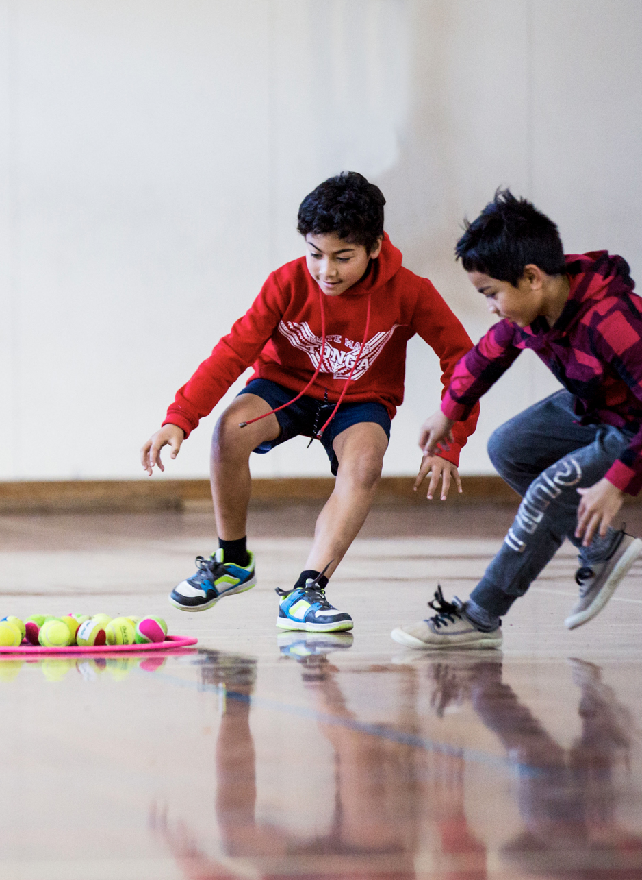
What can your organisation do?
Consider how your organisation can:
protect time for play
create welcoming places to play
reduce barriers to access
support inclusive play opportunities
include play in planning and decision-making
advocate for the value of play.
Small decisions can make
a big difference.

Slide 11
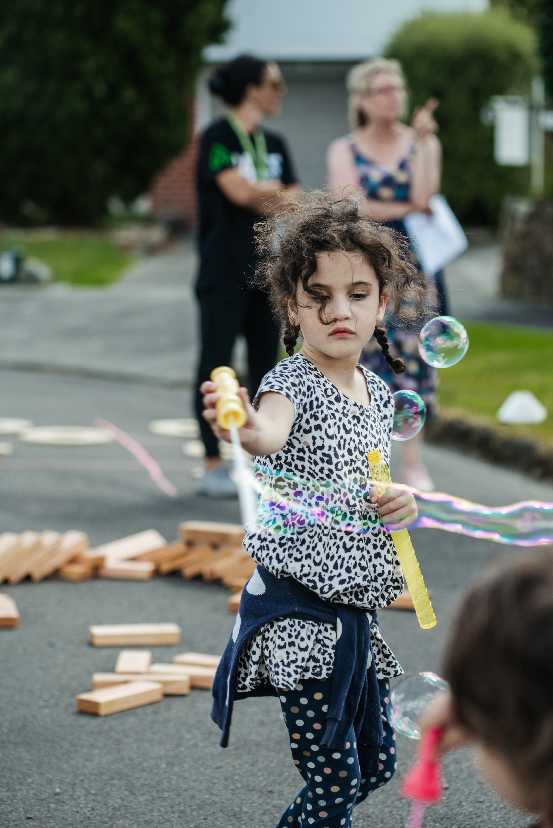
Play is essential
Play supports:
healthier tamariki
better wellbeing
improved learning
greater social connection and belonging
stronger cultural identity
more connected communities.
Valuing play is an investment in
healthier, stronger and more
connected communities.

Slide 12

Find out more: sportnz.org.nz/play

